Slide 1
FUNDAMENTAL RIGHTS AND EDUCATION RELATED ARTICLES IN INDIAN CONSTITUTION
DR. GOUTAM PATRA
ASSISTANT PROFESSOR , STAGE- II, WBES
GOVT COLLEGE OF EDUCATION, BANIPUR

Slide 2
Fundamental Rights
Fundamental Rights are incorporated from Aricle 12 to 35 in the Third Chapter of the Indian Constitution Rights are the basic facilities which we need for our growth.These are the claims of individual recognised by the society and enforced by the State.The existence of Democracy can’t be imagined without Fundamental Rights in India because Rights are the pillars of Democracy

Slide 3
Why do we call these Rights Fundamental?
These Rights are incorporated in the third Chapter of the Constitution of India.
They afford a basis for the development of an Individual.
The people and officials of India are ought to enjoy these rights.

Slide 4
Nature of Rights
Fundamental rights are equal for all.
Rights are justiciable – Article 32
Fundamental rights are not absolute.
They limit the authority of the central and state governments.
Fundamental rights distinguish between citizens and foreign nationals.
They can be suspended during emergency.
Parliament can amend Fundamental rights.

Slide 5
Right to Equality, Article-14 to 18
Equality before law Article-14 provides that «the state shall not deny to any person equality before law or the equal protection of law within the territory of India ».
Prohibilition of Descrimination, Article-15
Equality of opportunity Article-16
Abolition of untouchability Article-17
Abolition of titles Article-18

Slide 6
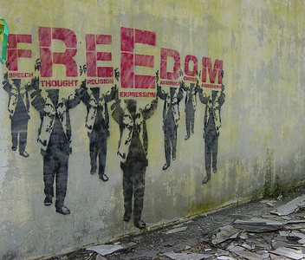
Right to Freedom
Article 19 to 22

Slide 7
Right to Freedom
Freedom of speech and expression Article-19
Freedom of Press – Article-361 A has been inserted according to which the press has been given the power to publish an account of the proceedings of the Indian Parliament and states legislatures.
Right to information is linked to the freedom of speech and expression granted in Article 19 in the constitution.
Freedom to assemble peacefully without Arms.
Freedom to form associations and unions.
Freedom to move freely throughout the territory of India.
Freedom to reside and settle in any part of the territory of India.
Freedom to practise any profession or to carry on any occupation,trade or business.
Protection in respect of conviction of an offence Article-20
Protection of life and personal liberty Article-21
Right to education Article-21 A
Protection against arrest and detention against certain cases Article-22

Slide 8
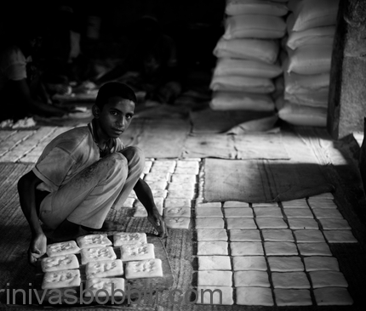
Right against Exploitation
Article 23-24

Slide 9
Right against exploitation,Article-23-24
Prohibition of traffic in human beings and forced labour Article23: This article prohibits the traffic in human beings and forced labour.
Prohibition of compulsary services Article-23 : under this article the state can force people to do compulsory service for public purposes.
Prohibition of Child Labour Article-24: Children below the age of forteen years will not be allowed to work in factories, mines or in other dangerous places so that their health is not adversely affected.

Slide 10
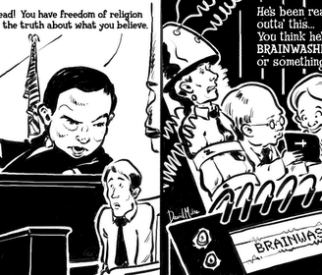
Right to Religious Freedom
Article 25 to 28

Slide 11
Right to religious freedom, Article-25 to 28
Freedom to profess and propagate any religion,Article-25
Freedom to manage religious affairs, Artcle-26
Freedom not to pay taxes for the promotion of any particular religion,Article-27
No religious instructions in government educational institutions,Artcle-28(1)
In private educational institutions religious education not against the will,Article-28(3)

Slide 12
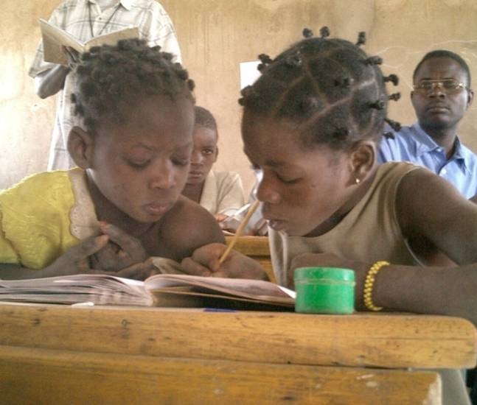
Cultural and educational rights
Article 29 to 30

Slide 13
Cultural and educational rights,Article 29 to 30
Protection against interest of minorities,Article-29(1)
Freedom to get admission in educational institutions,Article-29(2)
Right to minorities to establish educational institutions,Article-30(1)
No discrimination while giving grants-Article-30(2)

Slide 14
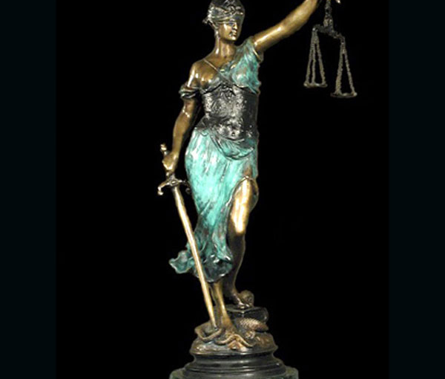
Right to Constitutional Remedies.
Article-32

Slide 15
Right to constitutional remedies,Article-32
Article-31(1), provides that a citizen can approach the supreme court of India by due process of law for the implementation of the Fundamental Rights included in Chapter 3 of the constitution.
Article-32(2), the Supreme court of India has the right to issue writs in the nature of the Habeas Corpus,Mandamus,Prohibition,etc.
Article-32(3), The Indian Parliament can empower any court to issue notice within its jurisdiction without infringing or influencing the powers of the Supreme Court of India.
Article-32(4), the state cannot suspend the right to constitutional remedies except in cases provided in the Indian Constitution.

Slide 16
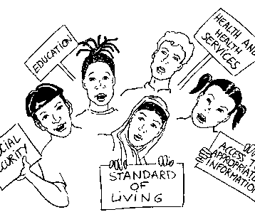
Critical Evaluation of Fundamental Rights
Public Opinion

Slide 17
Critical evaluation of fundamental rights
No rights outside the constitution
Too many limitations
Preventive Detention and Fundamental rights
Rights can be suspended during emergency
Absence of Economic rights
Vague and complex language
Supremacy of Parliament over Fundamental Rights
Special concessions for minorities and backward classes are against the Principle of Equality.

Slide 18
Importance of Human Rights
Foundation of democracy
Check on the arbitrariness of the Government
Create proper conditions for the development of Men
Foundation of Rule of law
Establishment of Secular state
Protection of the interests of the minorities
Reconciliation between individual interests and social interests.

Slide 19
6.What Is The constitution of India?
8. Fundamental Duties (Part IV Article 51A )- These Fundamental rights have been provided at the cost of some fundamental duties. These are considered as the duties that must be and should be performed by every citizen of India. These fundamental duties are defined as: It shall be the duty of every citizens of India: -
To abide by the Constitution.
To uphold & protect the sovereignty, unity and integrity of India.
To Cherish & follow the noble ideas which inspired our national struggle for freedom
To defend the country & render national service when called upon to do so.
To promote harmony & the spirit of common brotherhood.
To value & preserve the rich heritage of our composite culture.
To protect & improve the national environment.
To develop the scientific temper, humanism and the spirit of inquiry and reform.
To safeguard public property & to abjure violence.
To strive towards excellence in all spheres of individual & collective activity, so that the nations constantly rises to higher levels of endeavor & achievement.

Slide 20
Union List and Educational Articles
Article-62: National Library, Indian Museum Imperial War Museum and Victoria Memorial will run on central grant and will be considered as National Property
Article-63: Benaras Hindu University,Aligarh University, Delhi University and other Inst. Under Parliamentary Act are considered as National Institute.
Article- 64: All Science and Technological Institutes recognised by the Parliament are considered as National Institutes.

Slide 21
Union List
Union Agencies are the following Institutes:
Article-65:the Training Institutes of Military and Paramilitary Forces and Technical Inst. of Crime Control Board,
Article-66: Research Institute of Science and Technology of Higher Education
Article-67:Ancient Monument and Archaeological Sites

Slide 22
STATE LIST
Article -11: All Educational Institutes excluding in the list of Aticles- 63, 64,. 65, 66 will run by the Aids of State Governments
Article-12: Library, Museum, Historical Sites , Monuments excluding in the Article 62 and 67 will be maintained by the State

Slide 23
Concurrent List
Article-23: Economic and Social Planning
Article-25: Vocational and Technical Institutes,
Article-26: Law, Mechanical and other profession related
Article-27: Govt. Aids and Aiding agencies
Article-39: News paper, Books, journals and Printing Industry
Article: 4o : Archaeological cites except the cites declared by the Parliament as National Property

Slide 24
The Centre- State Relation
From Article 245 to 300 in the part XI and XII are related to Centre –State Relationship
The Parliament has the power to legislate any part of the territory of India
Parliament has the power of extra territorial legislation that means Union Parliament will govern any person property and Indian subjects anywhere in the world
Predominance of Union Law in the Jurisdiction of State in case of repungency

Slide 25
Expansion of the Legislative Power of the Union
For the sake of National Interest
Under the Proclamation of National or Financial Emergency
On agreement between states or on consent of State Legislature
To Implement Treaties
Under a Proclamation of Failure of Constitutional Machinery in the States ,The President as Executive Head(Article 356-A)
During Emergency , State Govt. under complete control of the Union(Article 353-A)
Financial Emergency-(Article 360-3/4)

Slide 26
Reforming The relation
The Stalvad Study Team: recommended an Inter-State Council to rationalize the relationship
The Administrative Reforms Commission: Formation of Inter-State Council taking representatives from 5 Zonal Councils
Rajamannar Committee: Recommended abolition of Planning Commission, Deletion of some articles empowering Centre ,Equal representation to Rajya sabha
Sarkaria Commission: Recommended Inter –Govt. Council, Inter-State Council Minimal Use of Art.356

